Slide 1

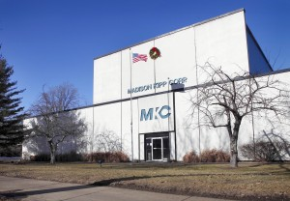

Site Investigation Report and Conceptual Site Model
Madison-Kipp Corporation
April 10, 2013
Imagine the result

Slide 2
Presentation Outline
Present a summary of investigation activities and conclusions
Present the Conceptual Site Model (CSM)
Present in-situ chemical oxidation (ISCO) pilot test results
Solicit concurrence on next steps:
  Soil
  Soil Vapor
  Groundwater

Slide 3
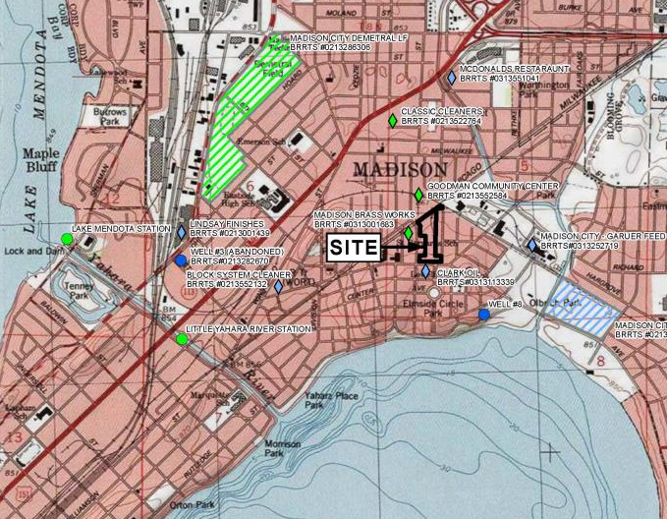
Site
Location

Slide 4
Summary of Investigation Activities (February 2012 through January 2013)
Activity | Media | Date
SVE system installation | Soil vapor | Feb 2012
Off-site residential vapor sampling | Indoor air and sub-slab vapor | March – July 2012, Jan 2013
Bike path vapor probes | Soil vapor | March 2012
Vapor probe monitoring | Soil vapor | March and Oct 2012
On-site exterior soil borings | Soil | June and Aug 2012
On-site interior soil borings | Soil | Oct 2012 and Jan 2013
Off-site residential soil borings | Soil | April – Aug and Nov 2012
Shallow well installation | Groundwater | April and Nov 2012, Jan 2013
Bedrock well installation | Groundwater | Sept 2012 – Jan 2013
Pilot test well installation | Groundwater | Oct – Nov 2012
Groundwater sampling | Groundwater | April, May, Nov, and Dec 2012, Jan 2013
8 SVE wells
189 on-site soil borings
78 off-site soil borings
10 single-screen MWs
4 multi-port MWs (20 intervals)
10 pilot test wells
4 vapor probes (bike path)
22 sub-slab vapor probes (11 homes)

Slide 5
Site Investigation Conclusions
Soil
  On-site and off-site investigation activities are complete
  189 on-site soil borings and 78 off-site hand auger boring locations.
  327 on-site and 183 off-site soil samples submitted for laboratory analyses including VOCs, PCBs, PAHs, and/or RCRA metals. 12 soil samples submitted for laboratory analysis of PCB homolog.

Slide 6
Site Investigation Conclusions
Soil (continued)
  VOCs:
    Concentrations above soil criteria generally observed on site near the former oil shed in the upper 2 feet of soil.
    Concentrations were reported below soil criteria off site.
    Concentrations decrease with depth and were delineated by on-site and off-site soil results.
  VOCs Recommendations:
    On-site engineered barrier, GIS Registry

Slide 7
Site Investigation Conclusions
Soil (continued)
  PCBs:
    Concentrations above soil criteria generally on site along the western property line, under the building and under the north parking lot in the upper 4 feet of soil, and below the building greater than 4 feet.
    Concentrations decrease with depth and are delineated.
    Concentrations above 50 mg/kg in the north parking lot were excavated in December 2012/January 2013.
  PCBs Recommendations:
    Removal of off-site soils above 0.22 mg/kg at four residences (241, 245, 253, and 257 Waubesa Street) and soils from 249 Waubesa at WDNR request
    On-site engineered barrier, GIS Registry

Slide 8
Site Investigation Conclusions
Soil (continued)
  PAHs
    Concentrations above soil criteria were generally observed across the site.
    Concentrations decrease with depth and are delineated.
    Concentrations off-site were determined to be background and not attributed to MKC activities.
  PAHs Recommendations:
    On-site engineered barrier, GIS Registry
    No further action off site by MKC (background)

Slide 9
Site Investigation Conclusions
Soil Vapor
  VOCs (on site):
    SVE system: Installed in February 2012 along the eastern property line of the north parking lot to mitigate the potential migration of soil vapors.
    Soil vapor probes: Samples collected in October 2012 indicated decreased concentrations and only VP-102 contained a vapor VOC exceedance of the residential screening level. VP-102 is within the influence of the SVE system.

Slide 10
Site Investigation Conclusions
Soil Vapor (continued)
  VOCs (off site):
    Off-site Residential:
      Sub-slab and indoor vapor samples collected by ARCADIS did not detect VOCs that exceeded the Wisconsin vapor action levels or calculated residential screening levels.
      Two indoor air samples (113 South Marquette Street and 249 Waubesa Street) collected by the WDNR’s consultant indicated a concentration of TCE above the residential vapor action level. Split samples and subsequent samples did not confirm the TCE concentrations.
      WDNR’s consultant installed SSDSs at these residences (113 South Marquette Street and 249 Waubesa Street) in 2012.
  VOCs Recommendations:
    On-site SVE system and vapor probe monitoring program
    No additional residential vapor sampling
    Maintenance of 5 existing SSDSs installed by MKC

Slide 11
Site Investigation Conclusions
Groundwater
  VOCs:
    55 groundwater sample locations exist: 35 monitoring wells and 4 multiport wells (20 sampling locations).
    Samples were collected from all locations and submitted for laboratory analysis of VOCs, PCBs, PAHs and/or dissolved RCRA metals.
    Groundwater VOC concentrations above the ES at most on-site well locations.
    Primarily a south to southeast horizontal hydraulic gradient direction and a downward vertical hydraulic gradient at the Site.

Slide 12
Site Investigation Conclusions
Groundwater (continued)
  VOCs:
    PCE concentrations are delineated in the Unconsolidated Aquifer and Lower Lone Rock Formation. PCE is delineated in the Upper Wonewoc Formation to the east and west. The plume is delineated vertically on site by Monitoring Wells MW-3D3 and MW-5D3.
  VOCs Recommendations:
    Completion of site investigation via monitoring well installation southeast of site; ongoing ISCO pilot monitoring program to evaluate results and support full-scale design
    No well is recommended to the north based on regional groundwater flow, potential unidentified upgradient sources.

Slide 13
Site Investigation Conclusions
Groundwater (continued)
  PAHs:
    Groundwater PAH ES exceedances were only reported at MW-3D3.
    MW-3D3 was re-sampled in March 2013 and PAH concentrations were not detected verifying anomalous data point.
  PAHs Recommendations:
    No additional sampling.

Slide 14
Site Investigation Conclusions
Groundwater (continued)
  PCBs:
    PCB exceedances at Monitoring Wells MW-22S, MW-22D and MW-23D in the initial round of sampling (January 2013), within the building footprint.
    Monitoring Wells MW-22S, MW-22D, and MW-23D were re-sampled in March 2013. MW-22S and MW-22D contained PCBs in the unfiltered groundwater samples. Filtered samples were non-detect for PCBs. MW-23D did not contain PCBs in filtered or unfiltered samples.
    March 2013 results indicate that PCBs are not present in groundwater in the dissolved-phase and are instead adhered to sediment particles in the unfiltered samples.
  PCBs Recommendations:
    One additional round of confirmation samples for filtered and unfiltered PCBs from MW-22S and MW-22D during the April 2013 groundwater monitoring event.

Slide 15
Site Investigation Conclusions
Groundwater (continued)
  RCRA Metals:
    ES exceedances were only reported at Monitoring Well MW-3S with exceedances of chromium and mercury.
    PAL exceedances of RCRA metals were limited to the north parking lot and under the building with exceedances of chromium, lead, mercury and arsenic.
    The metal exceedances are limited to the on-site well locations.
    MW-3S was re-sampled in March 2013. Concentrations decreased from January 2013.
  RCRA Metals Recommendations:
    No additional monitoring is recommended. However, RCRA metals will continue to be monitored as part of the ISCO post-injection monitoring program.

Slide 16
Conceptual Site Model (CSM)
Development of a successful remedial strategy is dependent on the assembly and testing of the Conceptual Site Model (CSM).
CSM synthesizes relevant data including:
Historical site use,
Geologic and hydrogeologic conditions,
Nature and extent of contamination,
Transport mechanisms, and
Potential receptors.

Slide 17
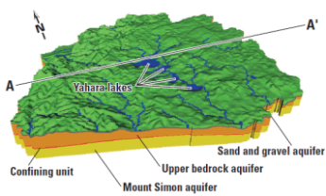
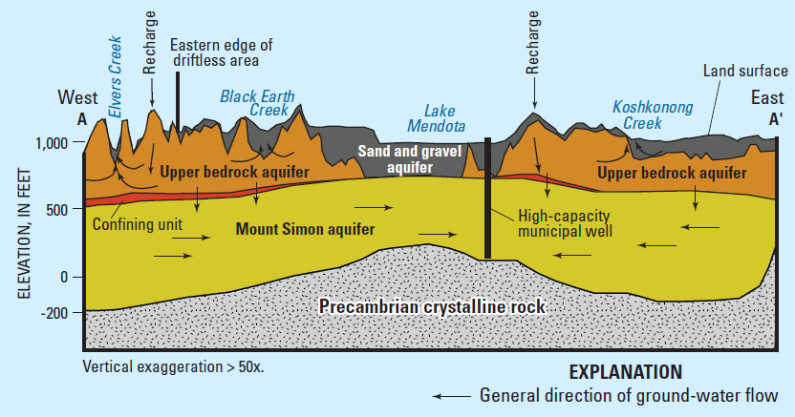
Regional Geology
(USGS, 2001)

Slide 18
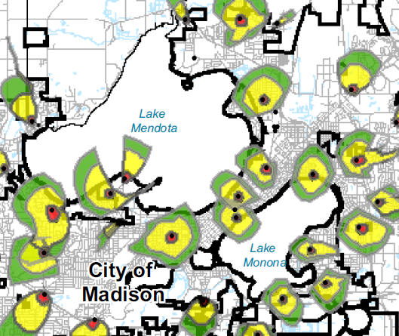
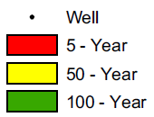
SITE
LOCATION
Regional Pumping Centers
Half-Capacity Pumping Rates
Unit Well 11
Unit Well 24
Unit Well 8
(Dane County, 2004)

Slide 19
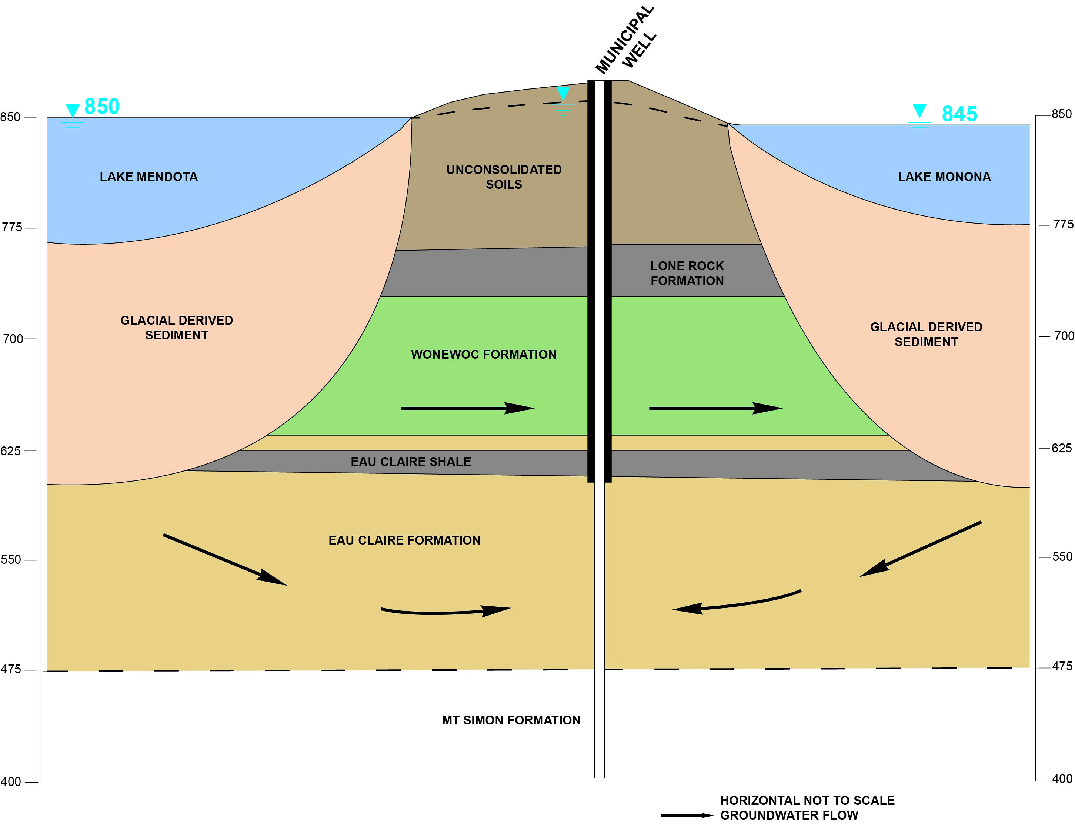

Slide 20
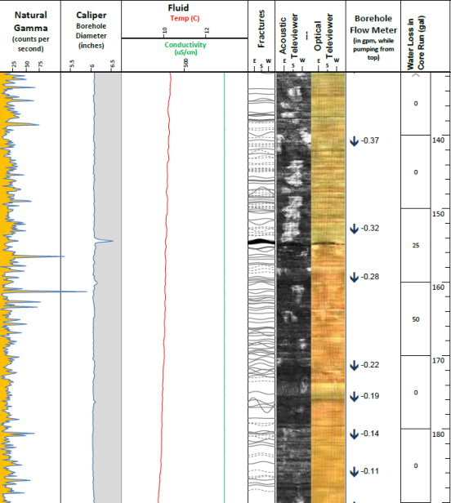
Geophysical
Data Collection
Gamma
Caliper
Temperature
Conductivity
Acoustical Televiewer
Optical Televiewer
Heat Pulse Flow Meter

Slide 21
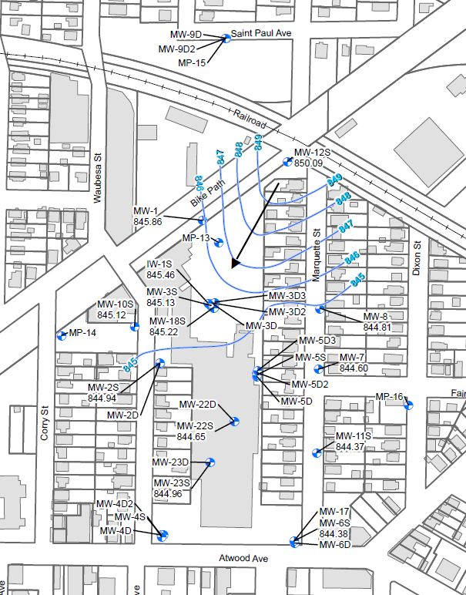
Unconsolidated Aquifer
Potentiometric Map
(0 – 30 feet bls)
Lake Mendota maintained at a higher elevation than Yahara River and Lake Monona.
Flow direction:
southeast
Horizontal gradient: 0.01 – 0.001 ft/ft

Slide 22
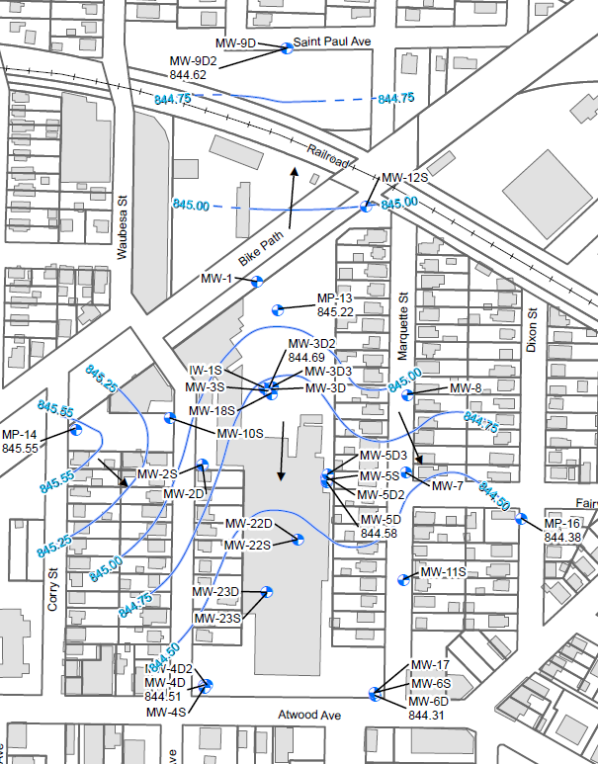
Lower Lone Rock Formation
Potentiometric Map
(60-95 feet bls)
Flow direction: predominantly south-southeast
Horizontal gradient: 0.01 – 0.001 ft/ft

Slide 23
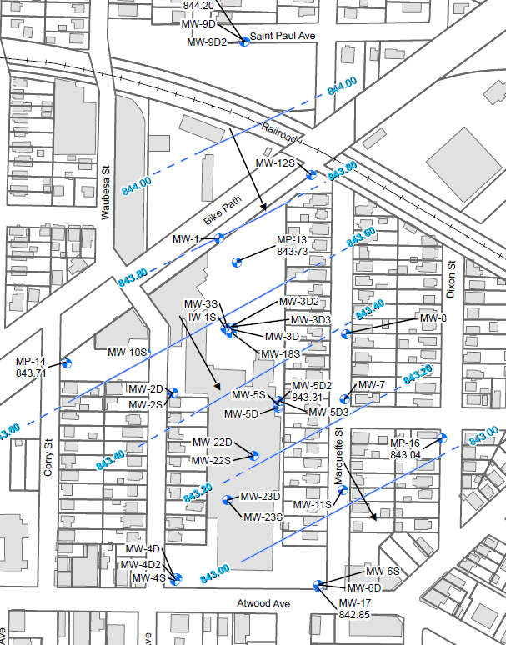
Lower Wonewoc Formation
Potentiometric Map
(120-220 feet bls)
Flow direction:
southeast
Horizontal gradient:
0.001 ft/ft

Slide 24
Downward Vertical Gradients
Average Vertical Gradients
Unconsolidated Aquifer to the Lone Rock Formation | -0.011 to -0.084 ft/ft
Lone Rock Formation to the Lower Wonewoc Formation | -0.012 to -0.033 ft/ft
Lone Rock to the Wonewoc Formation | -0.013 to -0.019 ft/ft
  Exceptions include: MP-15, MW-9D, and MW-9D2 where upward gradients observed (~0.002 ft/ft)

Slide 25
Hydraulic Conductivity
Geologic Unit | Hydraulic Conductivity Range (feet/day) | Hydraulic Conductivity Average (feet/day)
Unconsolidated Aquifer | 0.09 - 1.6 | 0.5
Lower Lone Rock Formation | 3.7 – 7.6 | 5.5
Upper Lone Rock Formation | 0.08 – 13.2 | 5.9
Upper Wonewoc Formation | 2.7 – 3.1 | 2.8
Lower Wonewoc Formation | 12.7 – 13.1 | 12.9
Wonewoc/Eau Claire Formations | 7.9 – 9.1 | 8.4

Slide 26
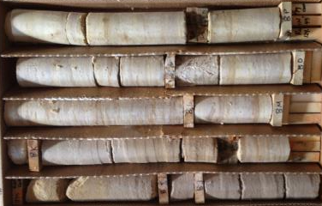
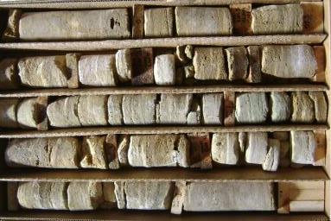
Dual-Porosity Bedrock Transport
Primary Porosity
17% – 29%
Chemical fate and transport in fractured bedrock groundwater occurs via combination of advection, diffusion and other mechanisms (hydrophobic sorption, chemical transformation)
Volume of groundwater in matrix porosity greatly exceeds that of the fracture porosity
Diffusion gradients between mobile fracture porosity and immobile matrix porosity contribute to chemical storage and retard transport
Matrix
Secondary Porosity
0.06% – 0.08%
Fractures

Slide 27
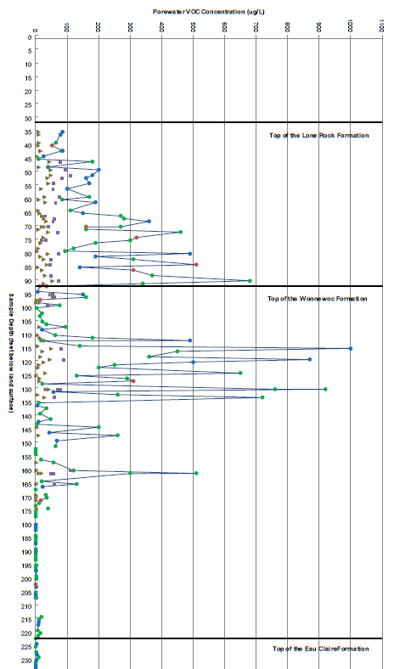
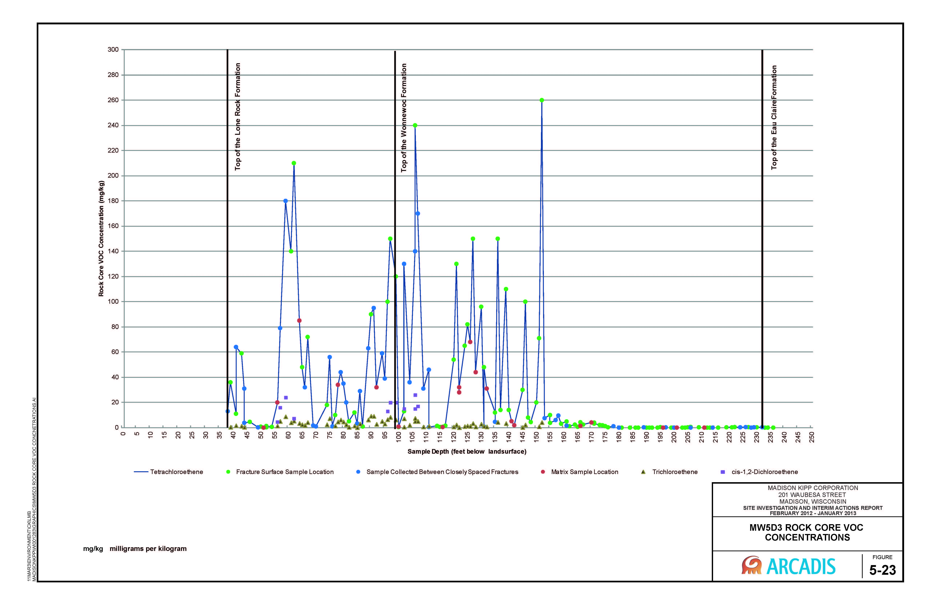
MW-3D3 Porewater VOCs
ISCO PILOT
INJECTION
INTERVALS
17 – 27
feet
Key Findings:
PCE rock concentrations ranged from non-detect to 190 mg/kg.
PCE concentrations in fracture and matrix samples are similar between ~60 to 90 feet. This implies that the PCE has likely penetrated the bedrock matrix.
PCE concentrations from fracture surfaces were higher than the matrix samples from ~110 to 140 feet indicating that PCE has not diffused into the bedrock matrix.
Negligible PCE porewater concentrations observed below 160 feet bls fracture zone.
60 – 90
feet
110 – 140
feet

Slide 28
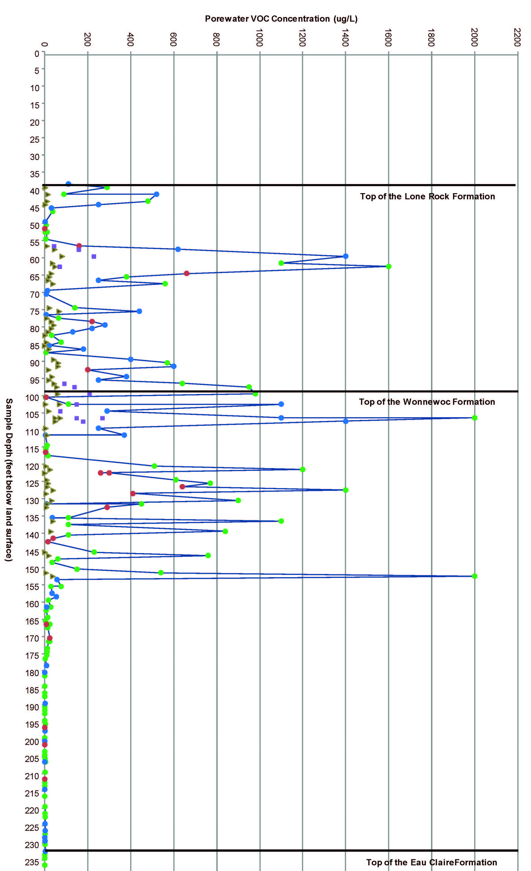
MW-5D3 Porewater VOCs
Key Findings:
PCE rock concentrations ranged from non-detect to 260 µg/kg.
PCE concentrations from the fracture surfaces were higher than the bedrock matrix samples collected. This indicates that PCE has not diffused into the bedrock matrix to an appreciable extent.
Negligible PCE porewater concentrations observed below 155 feet bls fracture zone.

Slide 29
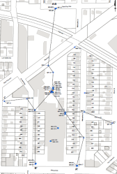
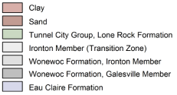
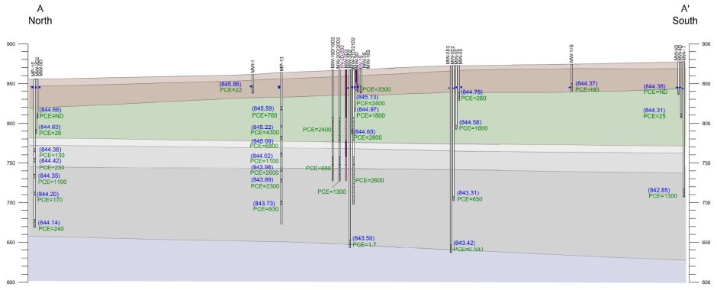
Geologic
Cross Section
(North-South)

Slide 30
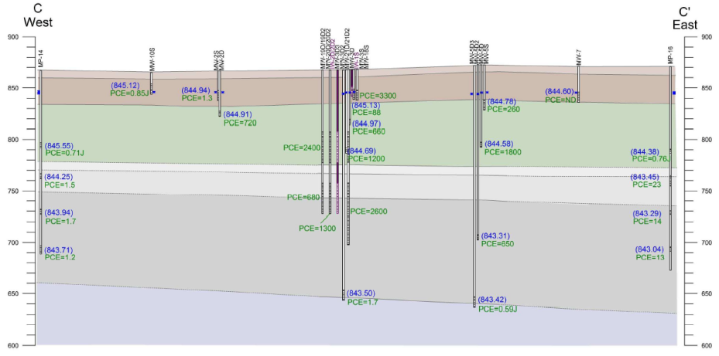
Geologic
Cross Section
(West-East)

Slide 31
Site Attenuation Data (PCE)
Data shown are representative of recent trends observed in selected wells

Slide 32
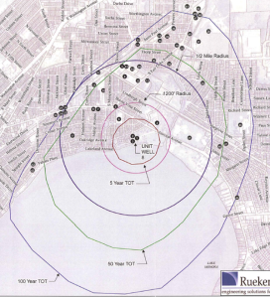
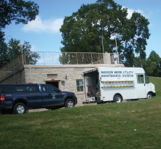
Unit Well 8
Open bedrock well from 280 – 774 feet bls
Cased below Eau Claire Shale in the Mount Simon Formation
Pump Capacity: 1,800 gpm
Recent Annual Pumping Volumes:
  2011: ~56,000,000 gallons (106 gpm)
  2012: ~870,000 gallons (1.7 gpm)
  Well Usage:
    Seasonal well use (July through August).
    Limited due to native iron and manganese levels above secondary standards.
  Iron and manganese are commonly found in Madison area bedrock groundwater.
  Causes yellow, brown, red, or black discolored water.
Iron/manganese filtration currently used or planned in other supply wells (Unit Wells 7, 10, and 29)

Slide 33
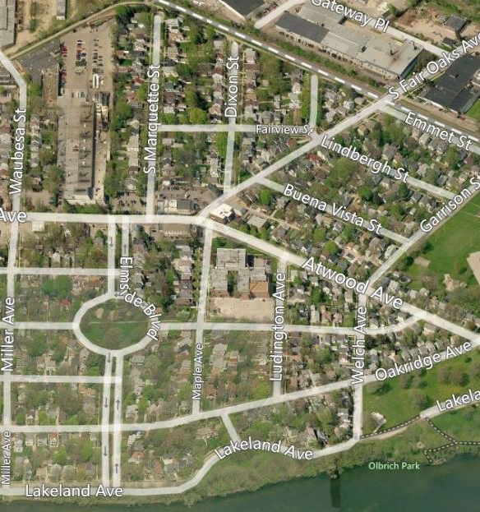
Additional
Investigation
Site
Well being installed:
~875 feet southeast of Site and ~625 feet northwest of Unit Well 8.
New Well MW-25
Unit Well 8
(Bing Maps, April 2013

Slide 34
Site Investigation Conclusions – Groundwater
Unconsolidated Aquifer and Lower Lone Rock Formation
Primary groundwater flow is vertically downward, and horizontally south/southeast
PCE concentrations are delineated
Upper Wonewoc Formation
Primary groundwater flow is south/southeast
Aquifer confined at the base by the Eau Claire Shale
PCE is vertically delineated on Site
PCE is delineated to the east and west
One additional well proposed southeast of site – consistent with dominant groundwater flow direction
No additional delineation wells proposed to north
  Hydraulically upgradient of site relative to dominant flow direction
  Suspected impacts from former dry cleaner
  MTBE at MW-9D2 suggests presence of other unidentified source(s)

Slide 35
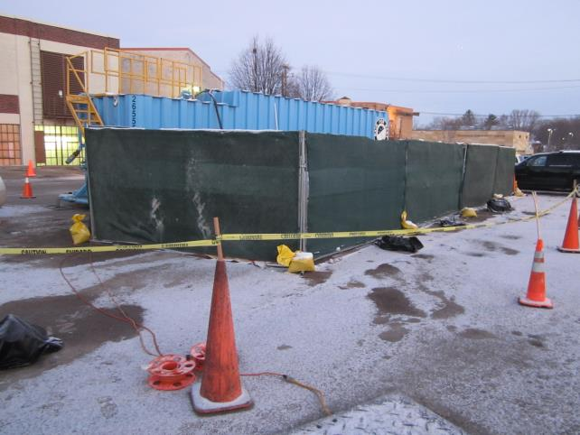
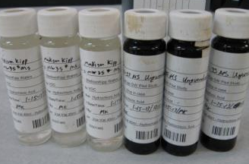
ISCO Pilot Testing and Full-Scale Remedial Design Considerations

Slide 36
Pilot Test Objectives
Determine hydraulic parameters required for full-scale remedy:
  Interconnectivity of bedrock fractures
  Oxidant and tracer distribution
  Injection design parameters for full-scale application
Determine PCE treatment extent
  While oxidant present
  After oxidant consumption
  Use above to determine injection network and dosing for injection event(s)

Slide 37
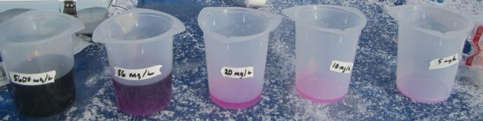
Injection
Specifics
Detail | Unconsolidated | Shallow Bedrock | Deep Bedrock
Vertical interval | 20 – 30 feet | 60 – 90 feet | 110 – 140 feet
Injection volume | 2,350 gallons | 7,000 gallons | 9,000 gallons
Injection solution | Permanganate and deuterated water | Permanganate and bromide | Permanganate and chloride
Flow Rates | 3 – 4 GPM | 13 – 14 GPM | 6 – 7 GPM
Distribution | 10 – 15 feet | 20 feet | 20 feet

Slide 38
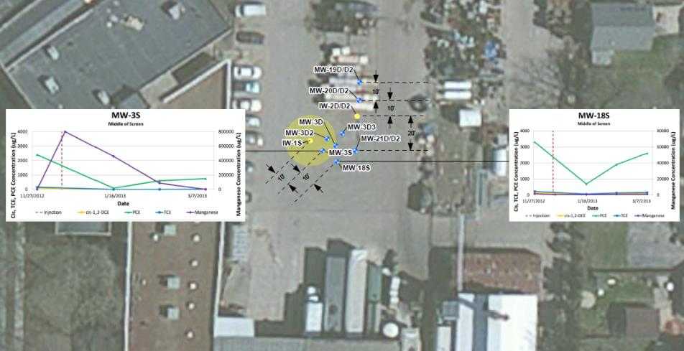
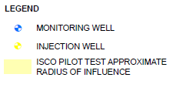


Unconsolidated Soils (20 – 30 ft)

Slide 39
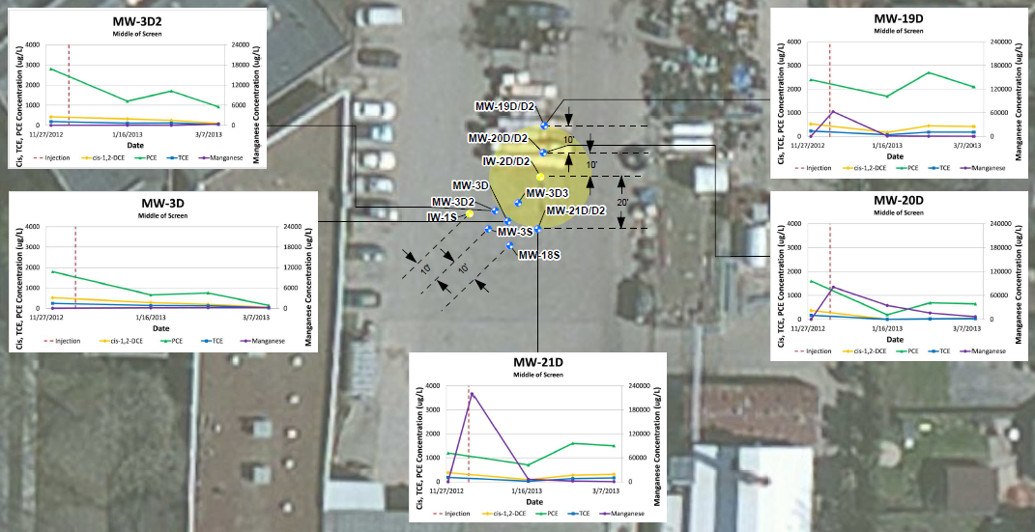
Shallow Bedrock (60 – 90 feet)

Slide 40
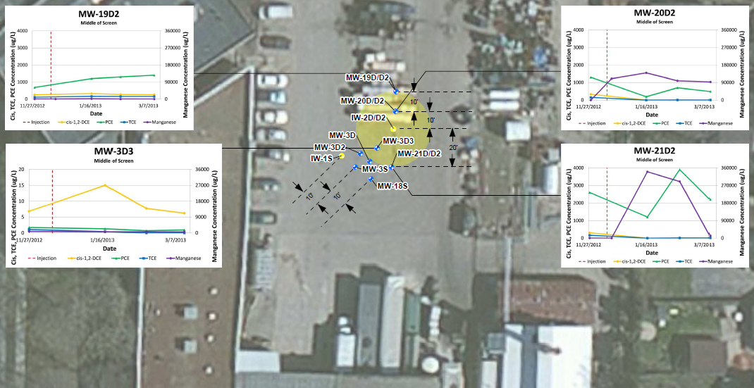
Deep Bedrock (110 – 140 feet)

Slide 41
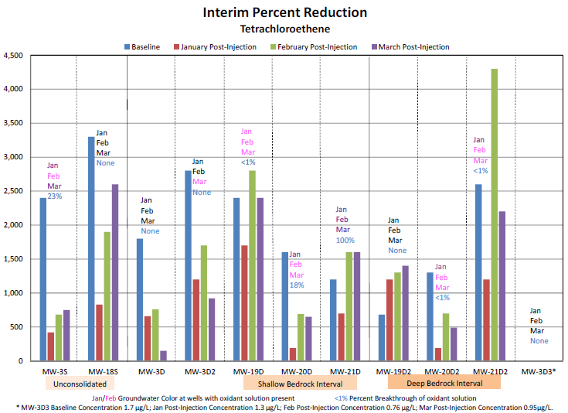
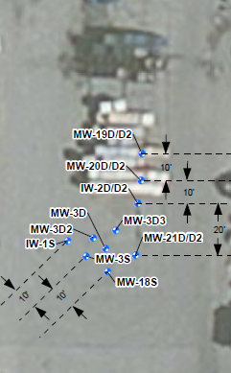
Interim ISCO PCE Reduction

Slide 42
ISCO Conclusions
Hydraulic objectives:
Achieved distribution in all three vertical intervals – demonstrates fractures are interconnected
Determined necessary injection volumes and well spacing to support delivery
Treatment objectives:
PCE destruction while oxidant present
Extended longevity of oxidant
Observed rebound where oxidant dosing was lower; provides evidence of matrix back diffusion

Slide 43
ISCO Recommendations
Additional monitoring activities (1 – 2 events) planned to continue evaluating PCE concentrations and oxidant longevity.
Additional data collection to provide further insight into dual-porosity storage model.
Data will guide decisions and refine anticipated end points for both active and passive remedies.

Slide 44
Next Steps - Soil
Removal of off-site soils with PCBs above 0.22 mg/kg at four residences (241, 245, 253, and 257 Waubesa Street) and 249 Waubesa Street
  Homeowner meetings – targeted April 2013
  Excavation activities – Spring 2013 with WDNR and homeowner concurrence
    On-site engineered barrier
      Upgrade the current barrier – Summer/Fall 2013
      Cap Maintenance and Materials Handling Plan submittal – May 2013
    GIS Registry – upon site closure

Slide 45
Next Steps – Soil Vapor
On-site SVE system operation and maintenance – ongoing
Permanent SVE system installation – Spring 2013
Vapor probe monitoring program
  Bike Path - Quarterly 2013
  Site-wide – Semi-annual 2013
Residential Home SSDS Maintenance (5 homes) – 2013 Annual Inspection

Slide 46
Next Steps - Groundwater
Completion of site investigation via monitoring well installation southeast of site – April/May 2013
ISCO pilot monitoring program to evaluate results and support full-scale design (including MW-3S) – ongoing
Collection of one additional round of filtered and unfiltered samples from MW-22S and MW-22D – April 2013
Collection of site-wide groundwater samples – Quarterly 2013
Remedial design
  WDNR meeting - May 2013

Slide 47
Closing Discussion
MKC seeks WDNR concurrence for next steps for soil, soil vapor, and groundwater
Timing of WDNR response
  PAHs
  PCBs
  SI report

